Slide 1
P&C Loss Reserving Methods
UCSB PSTAT 183
May 2017
Janet Duncan, FCAS, FSA

Slide 2
Reserving Methods
“Selection of the most appropriate method of reserve estimation is the responsibility of the actuary. A competent actuary will ordinarily examine the indications of more than one method…”
“Knowledge of changes in underwriting, claims handling, data processing and accounting, as well as changes in the legal and social environment affecting the experience is essential to the accurate interpretation and evaluation of observed data and the choice of reserving methods.”

Slide 3
Common Reserving Methods
Expected Method
Development Method
Bornhuetter-Ferguson Method

Slide 4
Expected Method
Relies upon an initial expectation of loss
Used when little or no other data is available
In reserving, the initial expected loss (loss ratio) estimate may come out of the Pricing process, historical data, or industry data.

Slide 5

Expected Method
Coin Toss Example A:
Suppose you toss a coin 20 times and have to pay $1 each time the coin toss results in “tails”.
What is your expected payout?

Slide 6
Development Method
Assumes historical patterns repeat themselves.
Good when data is relatively stable/unchanging.

Slide 7
Development Method
Coin Toss Example B:
Suppose you already tossed the coin 10 times and experienced “tails” 8 times.
What is your expected total payout after completing all 20 tosses, using the Development Method?

Slide 8
Bornhuetter-Ferguson Method
Blends Expected Method and Development Method.
Considers actual observations to-date plus expectations into the future.
Stabilizes volatile outcomes.

Slide 9
Bornhuetter-Ferguson Method
…same Coin Toss Example B:
Suppose you already tossed the coin 10 times and experienced “tails” 8 times.
What is your expected total payout after completing all 20 tosses, using the Bornhuetter-Ferguson Method?

Slide 10
Definitions
Accident Year - The year in which a claim occurs.
Triangles - Format used to compile changes in cumulative claim activity over time in order to estimate patterns of future activity.
Development - Change in loss amounts between two points in time.
Development Age - The number of months since the beginning of an accident year.
Loss Development Factors - The ratio of losses at successive evaluations for a defined group of claims (e.g. accident year).

Slide 11
Compilation of a Paid Loss Triangle
The losses are sorted by the year in which the accident occurred.
The payments from inception are summed at the end of each year.
Losses paid to date are shown on the most recent diagonal.
The data is organized in this way to highlight historical patterns.

Slide 12
Compilation of a Paid Loss Triangle
Actuarial Configuration
Goal: Estimate the total ultimate paid
Data Evaluated as of 12/31/2016
Accident Year | Cumulative Paid Losses ($000 Omitted) Development Stage in Months |  |  |  |  |  | Final Total Cost
 | 12 | 24 | 36 | 48 | 60 | 72
2011 | 3,780 | 6,671 | 8,156 | 9,205 | 9,205 | 10,508 | ???
2012 | 4,212 | 7,541 | 9,351 | 10,639 | 11,536 |  | ???
2013 | 4,901 | 8,864 | 10,987 | 12,458 |  |  | ???
2014 | 5,708 | 10,268 | 12,699 |  |  |  | ???
2015 | 6,093 | 11,172 |  |  |  |  | ???
2016 | 6,962 |  |  |  |  |  | ???

Slide 13
Paid Loss Development Factors
Accident Year |  | Evaluation Interval in Months
 |  | 12-24 | 24-36 | 36-48 | 48-60 | 60-72 |  | 72 to Ultimate
2011 |  | 1.765 | 1.223 | 1.129 | 1.085 | 1.052 |  | ???
2012 |  | 1.790 | 1.240 | 1.138 | 1.084
2013 |  | 1.809 | 1.240 | 1.134
2014 |  | 1.799 | 1.237
2015 |  | 1.834
2016
Sample Calculation for Accident Year 2012:
12-to-24 Months |  |  | 1.790 | = | 7,541/4,212
From the end of the accident year (at 12 months) to the end of the following year (at 24 months), paid losses for 2003 grew 79%. During the next year (from 24 to 36 months), paid losses experienced an additional 24% growth (or development) and so forth.

Slide 14
Compilation of a Paid LDF Triangle
Accident Year |  | Cumulative Paid Losses ($000 Omitted) Development Stage in Months
 |  | 12 |  | 24 |  | 36
2011 |  | 3,780 |  | 6,671 |  | 8,156
2012 |  | 4,212 |  | 7,541
Accident Year |  | Cumulative Paid Losses ($000 Omitted) Development Stage in Months
 |  | 12-24 |  | 24-36
2011 |  | +6,671/3,780 |  | +8,156/6,671
2012 |  | +7,541/4,212

Slide 15
Compilation of Paid LDF Triangle
Accident Year |  | Cumulative Paid Losses ($000 Omitted) Evaluation Interval in Months
 |  | 12-24 |  | 24-36
2011 |  | +6,671/3,780 |  | +8,156/6,671
2012 |  | +7,541/4,212
Accident Year |  | Evaluation Interval in Months
 |  | 12-24 |  | 24-36
2011 |  | 1.765 |  | 1.223
2012 |  | 1.790

Slide 16
Paid Loss Development Factors
Loss Development Factors (LDFs) are also known as:
  Age-to-Age factors
  Link Ratios

Slide 17
Paid Loss Development Factors
Accident Year |  | Evaluations Interval in Months
 |  | 24-Dec | 24-36 | 36-48 | 48-60 | 60-72 | 72 to Ultimate
2011 |  | 1.765 | 1.223 | 1.129 | 1.085 | 1.085
2012 |  | 1.79 | 1.240 | 1.138 | 1.084
2013 |  | 1.809 | 1.240 | 1.134
2014 |  | 1.799 | 1.237
2015 |  | 1.834
2016
Average- All Years |  | 1.799 | 1.235 | 1.134 | 1.085 | 1.052
Average-Latest 3 Years |  | 1.814 | 1.239 | 1.134 | XXX | XXX
Average- Excl Hi & Lo |  | 1.799 | 1.239 | 1.134 | XXX | XXX
Wt Average-All Years |  | 1.803 | 1.235 | 1.134 | 1.085 | 1.052
Selected LDF |  | 1.800 | 1.235 | 1.134 | 1.085 | 1.052 | 1.070

Slide 18
Basic Reserving
Application of Paid LDM
LDFs |  | Evaluation Interval in Months
 |  | 12-24 | 24-36 | 36-48 | 48-60 | 60-72 | 72 to Ultimate
 |  | 1.8 | 1.235 | 1.134 | 1.085 | 1.052 | 1.070
Accident Year | Cumulative Paid Losses ($000 Omitted) Development Stage in Months |  |  |  |  |  | Final Total Cost
 | 12 | 24 | 36 | 48 | 60 | 72
2011 | 3,780 | 6,671 | 8,156 | 9,205 | 9,990 | 10,508 | 11,244
2012 | 4,212 | 7,541 | 9,351 | 10,639 | 11,536 | 12,136 | 12,985
2013 | 4,901 | 8,864 | 10,987 | 12,458 | 13,517 | 14,220 | 15,215
2014 | 5,708 | 10,268 | 12,699 | 14,401 | 15,625 | 16,437 | 17,588
2015 | 6,093 | 11,172 | 13,797 | 15,646 | 16,976 | 17,859 | 19,109
2016 | 6,962 | 12,532 | 15,477 | 17,550 | 19,042 | 20,032 | 21,435
 |  | Sample Calculations for Accident Year 2016:
At 24 Months: |  | 12,532 = 6,962 x 1.800
At 36 Months: |  |  | 13,797 = 11,172 x 1.235
 |  |  | 15,477 = 6,962 x 1.800 x 1.235

Slide 19
Paid LDM Projections & Reserves
Loss Reserve Estimate @12/31/16 = $32.241 million
Accident Year | Actual Paid Losses 12/31/16 | Selected LDFs | Cumulative Development Factors to Ultimate | Estimated Ultimate Losses [(2) x (4)] | Actual Paid Losses 12/31/16 | Estimated Loss Reserves [(5) - (6)]
(1) | (2) | (3) | (4) | (5) | (6) | (7)
2011 | 10,508 | 1.070 | 1.070 | 11,244 | 10,508 | 736
2012 | 11,536 | 1.052 | 1.126 | 12,985 | 11,536 | 1,449
2013 | 12,458 | 1.085 | 1.221 | 15,215 | 12,458 | 2,757
2014 | 12,699 | 1.134 | 1.385 | 17,588 | 12,699 | 4,889
2015 | 11,172 | 1.235 | 1.710 | 19,109 | 11,172 | 7,937
2016 | 6,962 | 1.800 | 3.079 | 21,435 | 6,962 | 14,473
Total | 65,335 |  |  | 97,576 | 65,335 | 32,241

Slide 20
Issues to Consider for Paid LDM
Issues to Consider
Have there been any changes which might make the older years irrelevant?
Are the more recent years better predictors of the future?
Are there outlier points that need to be ignored or adjusted?
Examples
There are more motorcycle losses in the oldest year; but company no longer insures motorcycles.
Company has begun writing more business in state X.
In one year, there were bad ice storms at the end of December. Late reporting caused unusually high development in the next year.

Slide 21

Calculating Ultimate Loss: Paid Development Method
Ultimate Loss
Unpaid
(Liabilities)
Paid
Paid
© 2014 by the Casualty Actuarial Society. All rights reserved.

Slide 22

Calculating Ultimate Loss: Reported Loss Development Method
Ultimate Loss
Reported Loss
“IBNR”
Case Reserves
Case Reserves
Paid
Paid
© 2014 by the Casualty Actuarial Society. All rights reserved.
Notes:
Could use this slide to introduce concepts of case reserves & IBNR. Note that reported loss development method is analogous to paid loss development in terms of developing triangles, etc. Examples of both are in the excel workbook.

Slide 23
Compiling a Reported (aka Incurred) Loss Triangle
Accident Year | Case Reserves ($000 Omitted) Development Stage in Months
 | 12 | 24 | 36 | 48 | 60 | 72
2011 | 5,557 | 4,176 | 2,936 | 1,987 | 1,245 | 742
2012 | 6,328 | 4,664 | 3,200 | 2,051 | 1,189
2013 | 6,974 | 4,968 | 3,251 | 1,955
2014 | 7,635 | 5,274 | 3,367
2015 | 8,376 | 5,604
2016 | 9,599
Accident Year | Cumulative Paid Losses ($000 Omitted) Development Stage in Months
 | 12 | 24 | 36 | 48 | 60 | 72
2011 | 3,780 | 6,671 | 8,156 | 9,205 | 9,990 | 10,508
2012 | 4,212 | 7,541 | 9,351 | 10,639 | 11,536
2013 | 4,901 | 8,864 | 10,987 | 12,458
2014 | 5,708 | 10,268 | 12,699
2015 | 6,093 | 11,172
2016 | 6,962
Add➔
Add➔

Slide 24
Reported (aka Incurred) Loss Triangle
Accident Year | Cumulative Case Reported Loses ($000 Omitted) Development Stage in Months |  |  |  |  |  | Final Total Cost
 | 12 | 24 | 36 | 48 | 60 | 72
2011 | 9,337 | 10,847 | 11,092 | 11,192 | 11,235 | 11,250 | ???
2012 | 10,540 | 12,205 | 12,551 | 12,690 | 12,725 |  | ???
2013 | 11,875 | 13,832 | 14,238 | 14,413 |  |  | ???
2014 | 13,343 | 15,542 | 16,066 |  |  |  | ???
2015 | 14,469 | 16,776 |  |  |  |  | ???
2016 | 16,561 |  |  |  |  |  | ???

Slide 25
Selected Reported LDFs
Accident Year | Evaluations Interval In Months
 | 12-24 | 36-48 | 36-48 | 48-60 | 60-72 | 72 to Ultimate
2011 | 1.162 | 1.023 | 1.009 | 1.004 | 1.001 | ???
2012 | 1.158 | 1.028 | 1.011 | 1.003
2013 | 1.165 | 1.029 | 1.012
2014 | 1.165 | 1.034
2015 | 1.159
2016
Average- All Years | 1.162 | 1.029 | 1.011 | 1.004 | 1.001
Average- Latest 3 Years | 1.163 | 1.030 | 1.011 | XXX | XXX
Average- Excl Hi & Lo | 1.162 | 1.029 | 1.011 | XXX | XXX
Wt Average- All Years | 1.162 | 1.029 | 1.011 | 1.003 | 1.001
Selected LDF | 1.162 | 1.030 | 1.011 | 1.003 | 1.001
Cumulative LDF | 1.215 | 1.045 | 1.015 | 1.004 | 1.001 | 1.000

Slide 26
Reported LDM Projections & Reserves
Accident Year | Actual Reported Losses 12/31/16 | Development Factors to Ultimate | Estimated Ultimate Losses [(2) x (3)] | Actual Paid Losses 12/31/16 | Estimated Loss Reserves {(4) - (5)}
(1) | (2) | (3) | (4) | (5) | (6)
2011 | 11,250 | 1.000 | 11,250 | 10,508 | 742
2012 | 12,725 | 1.001 | 12,738 | 11,536 | 1,202
2013 | 14,413 | 1.004 | 14,417 | 12,458 | 2,013
2014 | 16,066 | 1.015 | 16,308 | 12,699 | 3,609
2015 | 16,776 | 1.045 | 17,539 | 11,172 | 6,367
2016 | 16,561 | 1.215 | 20,119 | 6,962 | 13,157
Total | 87,791 |  | 92,425 | 65,335 | 27,090

Slide 27
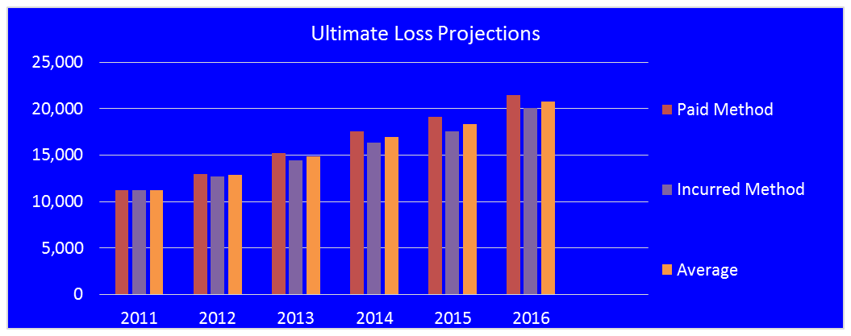
Comparison of LDM Projections
Accident Year | Estimated Ultimate Losses Based on:
 | Paid LDM | Reported LDM | Average= Selected
 | Paid Method | Incurred Method | Average
2011 | 11,244 | 11,250 | 11,247
2012 | 12,985 | 12,738 | 12,862
2013 | 15,215 | 14,471 | 14,843
2014 | 17,588 | 16,308 | 16,948
2015 | 19,109 | 17,539 | 18,324
2016 | 21,435 | 20,119 | 20,777
Total | 97,576 | 92,425 | 95,001

Slide 28
Comparison of Loss Development Methods
Underlying Assumptions
PLDM: No changes in the payment pattern
RLDM: No changes in case reserve adequacy
Pro
Con
PLDM: “Hard” data; no estimates involved
RLDM: Uses all available information
PLDM: May generate large, volatile loss development factors & take longer to develop to ultimate
RLDM: Uses case reserves, which are estimates, to develop estimates of ultimate losses

Slide 29
Comparison of Estimated Reserves
Which estimate is right?
Which estimate is best?
How will you know?
When will you know?

Slide 30
A Change in Estimated Ultimate Loss is often driven by:
Change in Catastrophe estimate
Large losses
Change in claim frequency (claim counts)
Change in claim severity (average claim size)
Random variation
External environmental factors
Emerging issues

Slide 31
Bornhuetter-Ferguson Method
Reserves Based on ELR and Actual Loss
Case Reserve + IBNR Reserve = Total Reserve
The IBNR Factor is the percent of expected losses unreported.
Where IBNR Factor = (1.000 - 1.000/CDF)
(EP x ELR) x (IBNR Factor) = (IBNR Reserves)
EP = Earned Premium; ELR = Expected Loss Ratio

Slide 32

B-F Applied to Non- Insurance
Given the following, how many home runs will Ryan Howard hit this year?
There are 160 games in a season and Ryan hit 40 homes runs last year.
There have been 40 games so far this year and Ryan hit 20 home runs.
Information needed to perform a
Bornhuetter-Ferguson (B-F) projection:
Expected Ultimate Value
Factor to Project to Actual Data to Ultimate
Actual Data To Date

Slide 33
B-F Applied to Non Insurance
Expected Loss Ratio Method
Ultimate Value = Expected Value = 40 Home Runs
Games 0-40 Games 41-80 Games 81-120 Games 121-160
10 Home Runs 10 Home Runs 10 Home Runs 10 Home Runs
Note: 40 Home Runs previously expected – 20 so far early in the season. Unless Ryan Howard is expected to slump, this method seems inappropriate.
Reported Loss Development Method
Since season is ¼ completed, multiply the current statistic by 4.
Ultimate Value = Incurred To Date * Cumulative LDF
= 20 * 4.000 = 80 Home Runs
Games 0-40 Games 41-80 Games 81-120 Games 121-160
20 Home Runs 20 Home Runs 20 Home Runs 20 Home Runs

Slide 34
B-F Applied to Non Insurance
B-F Projection: Ultimate Value =
(Expected Value*IBNR Factor)+(Inc. to Date)
IBNR Factor = 1.000 - (1.000/LDF) = 1.000 - (1.000/4.000) = .75
(In Other Words, 75% of the season is left to be played)
Ultimate Value = (40 * .75) + 20 = 50
The B-F Method projects that Ryan Howard will hit 50 home runs this year.
Games 0-40 Games 41-80 Games 81-120 Games 121-160
20 Home Runs 10 Home Runs 10 Home Runs 10 Home Runs

Slide 35


Bornhuetter-Ferguson Method
Accident Year |  |  | Evaluation Interval in Months
 |  |  | 12-24 |  | 24-36 |  | 36-48
2011 |  |  | 1.162 |  | 1.023 |  | 1.009
2012 |  |  | 1.158 |  | 1.028 |  | 1.011
2013 |  |  | 1.165 |  | 1.029 |  | 1.012
2014 |  |  | 1.165 |  | 1.034
2015 |  |  | 1.159
2016
Selected LDF |  |  | 1. 162 |  | 1.030 |  | 1.011 |  | Tail
Cumulative LDF |  |  | 1.215 |  | 1.045 |  | 1.015 |  | 1.004
IBNR Factor = 1.000 - 1.000/Cumulative Loss Development Factor
+1.000 - 1.000/1.215 +1.000 - 1.000/1.015
IBNR Factor |  |  | 0.177 |  | 0.044 |  | 0.015

Slide 36
Bornhuetter-Ferguson Method
Accident Year |  |  | Evaluation Interval in Months
 |  |  | 12-24 | 24-36 | 36-48 | 48-60 | 60-72 | 72 to Ultimate
2011 |  |  | 1.162 | 1.023 | 1.009 | 1.004 | 1.001 | ???
2012 |  |  | 1.158 | 1.028 | 1.011 | 1.003
2013 |  |  | 1.165 | 1.029 | 1.012
2014 |  |  | 1.165 | 1.034
2015 |  |  | 1.159
2016
Average - All Years |  |  | 1.162 | 1.029 | 1.011 | 1.004 | 1.001
Average - Latest 3 Years |  |  | 1.163 | 1.030 | 1.011 | XXX | XXX
Average - Excl Hi & Lo |  |  | 1.162 | 1.029 | 1.011 | XXX | XXX
Wt Average - All Years |  |  | 1.162 | 1.029 | 1.011 | 1.003 | 1.001
Selected LDF |  |  | 1.162 | 1.030 | 1.011 | 1.003 | 1.001 | 1.000
Cumulative LDF |  |  | 1.215 | 1.045 |  | 1.004 |  | 1.000
IBNR Factor = 1.000 - 1.000/Cumulative Loss Development Factor
IBNR Factor |  |  | 0.177 | 0.044 | 0.015 | 0.004 | 0.001 | -

Slide 37
Bornhuetter-Ferguson Method
Accident Year | Earned Premium | Assumed Expected Loss Ratio | Assumed Expected Losses | IBNR Factor | Estimated IBNR | Cumulative Incurred Losses | Estimated Ultimate Losses
(1) | (2) | (3) | (4) (2) X (3) | (5) | (6) (4) X (5) | (7) | (8) (6) + (7)
2011 | 18,168 | 62.00% | 11,264.16 | - | - | 11,250 | 11,250
2012 | 21,995 | 62.00% | 13,636.90 | 0.001 | 14 | 12,725 | 12,739
2013 | 24,173 | 62.00% | 14,987.26 | 0.004 | 60 | 14,413 | 14,473
2014 | 25,534 | 62.00% | 15,831.08 | 0.015 | 235 | 16,066 | 16,301
2015 | 31,341 | 62.00% | 19,431.42 | 0.044 | 846 | 16,776 | 17,622
2016 | 38,469 | 62.00% | 23,850.78 | 0.177 | 4,218 | 16,561 | 20,779
Total | 159,680 |  | 99,000.00 |  | 5,372 | 87,791 | 93,163

Slide 38
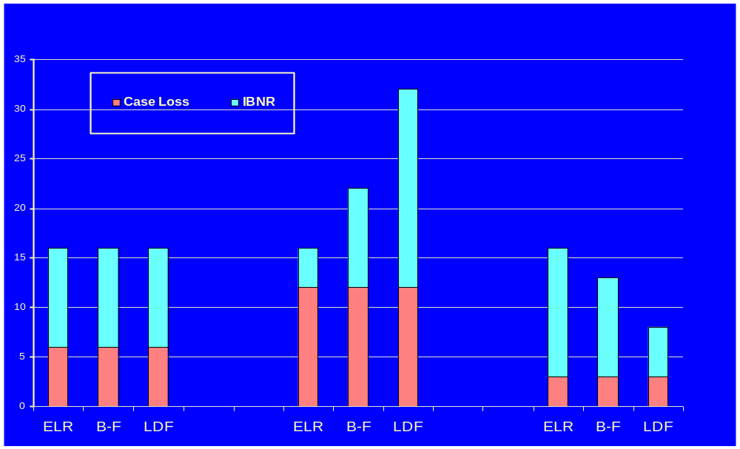
Comparison of Methods
Expected
Twice Expected
Half Expected

Slide 39
B-F METHOD
ADVANTAGES
Compromise between loss development and expected loss ratio methods
Avoids overreaction to unexpected incurred losses to date
Suitable for new or volatile line of business
Can be used with no internal loss history
Easy to use
DISADVANTAGES
Assumes that case development is unrelated to reported losses
Relies on accuracy of expected loss ratio
Less responsive to losses incurred to date
Relies on accuracy of earned premium

Slide 40
Formulas to Derive
IBNR Reserves
Once an estimate of ultimate loss has been obtained, the arithmetic of IBNR is straightforward
Ultimate Losses
Minus
Paid Losses
Minus
Case Reserves
Ultimate Losses
Minus
Reported Losses
Unpaid Losses
Minus
Case Reserves

